Slide 1

Computer Architecture
Keivan Navi
Cal Poly Pomona University
knavi@cpp.edu
Office hours: Tu/Th 5:25 Pm to 6:55 Pm
Office: 8-49

Slide 2
Computer Architecture
Asynchronous
Counter

Slide 3
Asynchronous Counters
Asynchronous ( clock is not applied to all of the Flip-Flops) counters use cascaded flip-flops to create binary counting sequences. Each flip-flop triggers the next, leading to accumulated propagation delays. These counters are simple to design but have limitations in speed and output timing. One of the main disadvantages of asynchronous counters is that they can be slower and less reliable than synchronous counters, since they have more propagation delay and glitches that can cause errors.
What is an asynchronous up/down counter?
An asynchronous up/down counter is a digital circuit that can either increment (count up) or decrement (count down) depending on the control inputs. Hence it is not controlled by a clock signal, meaning that it is asynchronous.

Slide 4
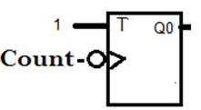
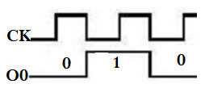
Asynchronous one bit Up Counter

Slide 5
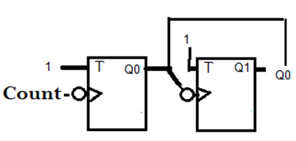
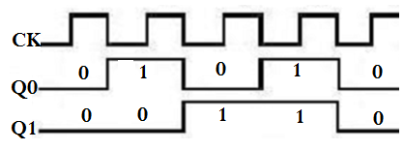
Asynchronous two bits up Counter

Slide 6
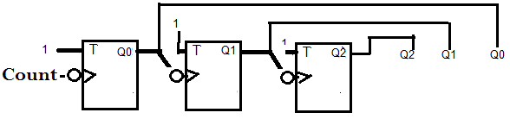
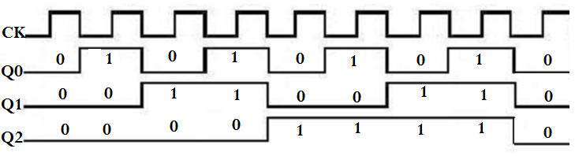
Asynchronous 3 bits Up Counter
It seems that is fully expandable.

Slide 7
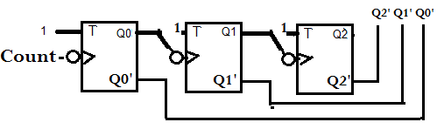
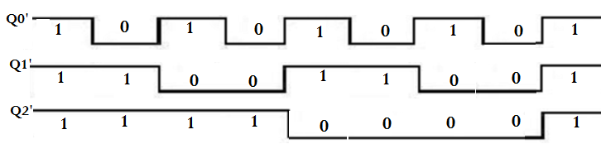
Asynchronous Down Counter Design

Slide 8
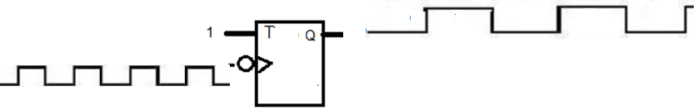
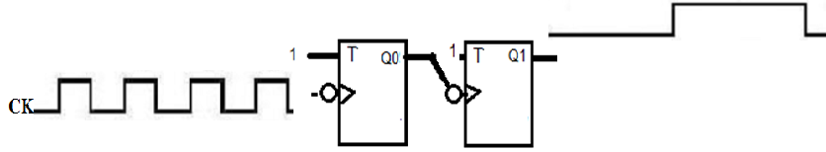
Dividing the frequency by 2 and 4
Dividing the frequency by 2:
Dividing the frequency by 4:

Slide 9
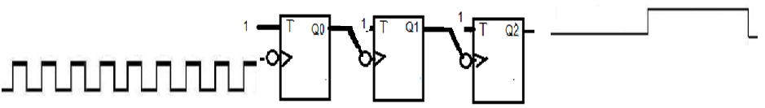
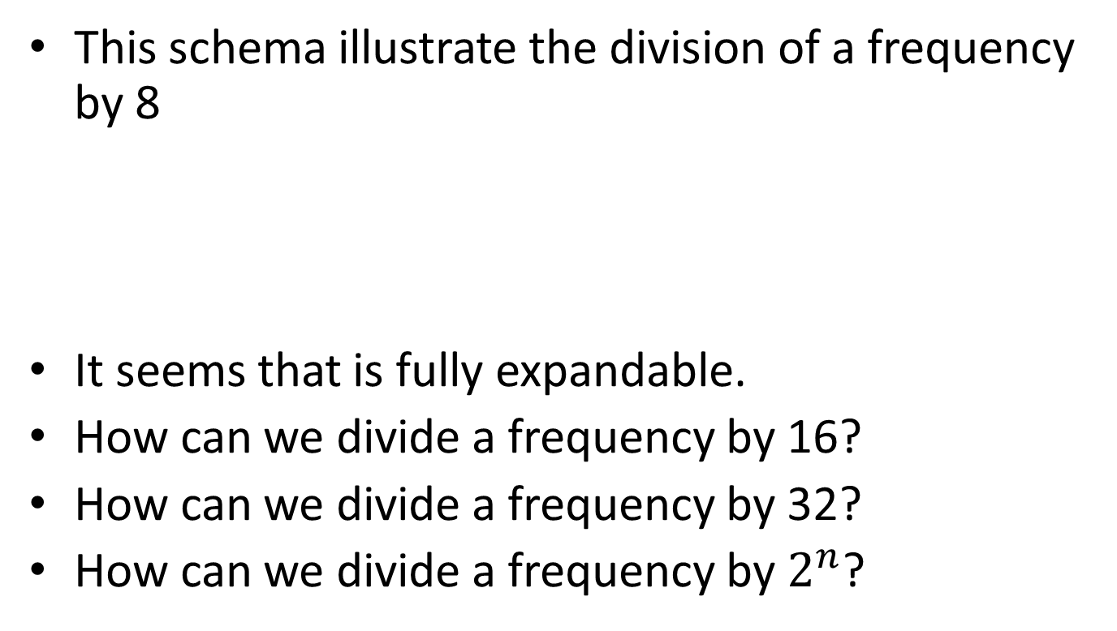
Dividing the Frequency by 8
This schema illustrate the division of a frequency by 8
It seems that is fully expandable.
How can we divide a frequency by 16?
How can we divide a frequency by 32?
How can we divide a frequency by $2^{n}$?

Slide 10

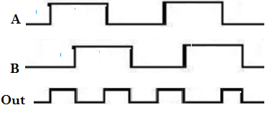
Multiplying a frequency by 2
Multiplying the frequency by 2:

Slide 11
Asynchronous up/down Counter
An asynchronous up-down counter includes a plurality of counter blocks. Each of the counter blocks has a counter output, an up-down control output, and an up-down control input. A counter signal output from each of the counter blocks has at least two bits.
A counter is a sequential circuit that goes through a prescribed sequence of states upon the application of input pulses. The input pulses called count pulses, may be clock pulses, or they may originate from an external source and may occur at prescribed intervals of time or at random.

Slide 12
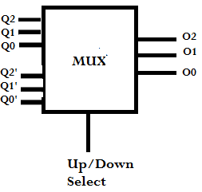
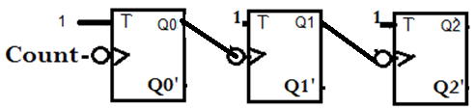
Asynchronous up/down Counter
If Up/Down Select=0 then this circuit will act as an Up Counter, If Up/Down Select=1 then it will act as a Down Counter

